Slide 1
Automating Instagram using Appium
M.Deekshitha
192011293
CSA3731-Software testing for Android Applications
31st Jan,2023

Slide 2
OBJECTIVE
Test the Instagram application using testcases and noting
down the test scenarios to improve the functionalities and
working of the Instagram.

Slide 3
ABSTRACT
To automate the Instagram applications which is mobile photo-sharing, video-sharing and social networking services that enables its users to take pictures and videos.
And also share them on a variety of social media networking platforms such as Facebook, twitter, tumbler etc.
The test processes include-
-Testing the code
-Test scenarios

Slide 4

PROPOSED SYSTEM
Installation of the softwares to automate the Instagram application are -
- Android studio : Visualization
- IntelliJ : To write code
- Appium : To automate the application
Performing tests for Instagram application such as –
- Verifying login credentials such as email and password.
- Verifying the number of viewers who view the story.
- Number of likes, comments and shares.
- Uploading a post.
- Reels
- Feed
- Friend Requests
- Followers and following
- Blocked accounts
- Highlights

Slide 5
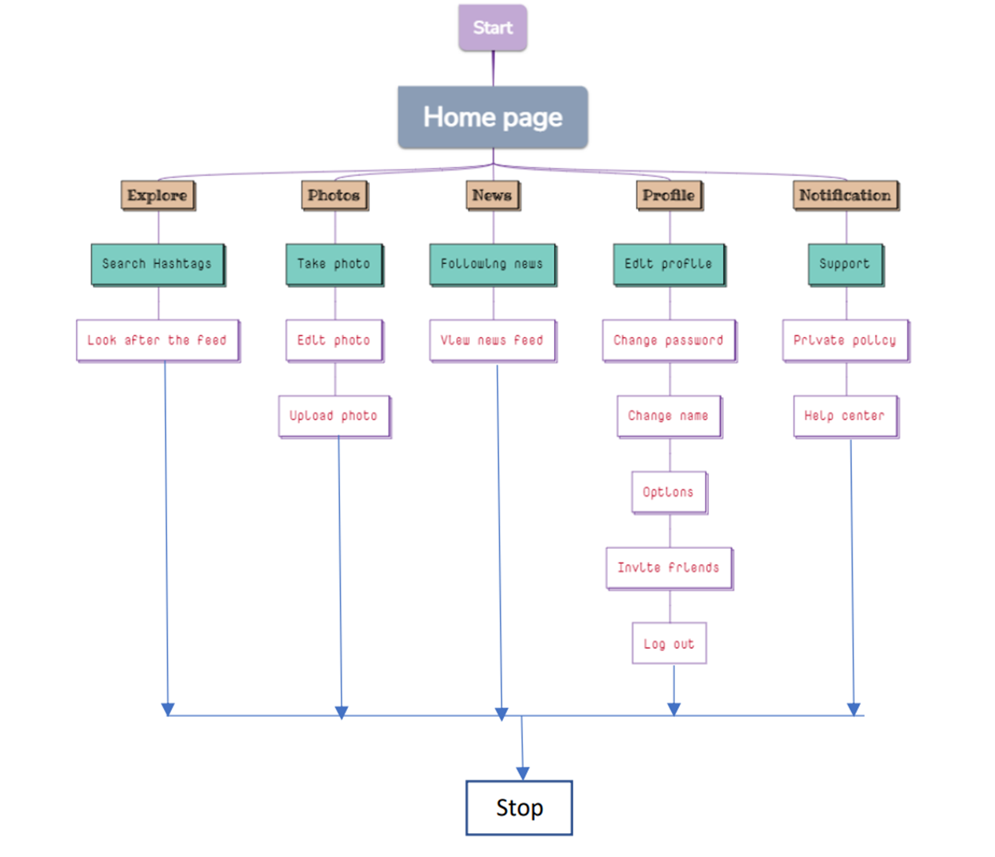
DATA FLOW DIAGRAM

Slide 6
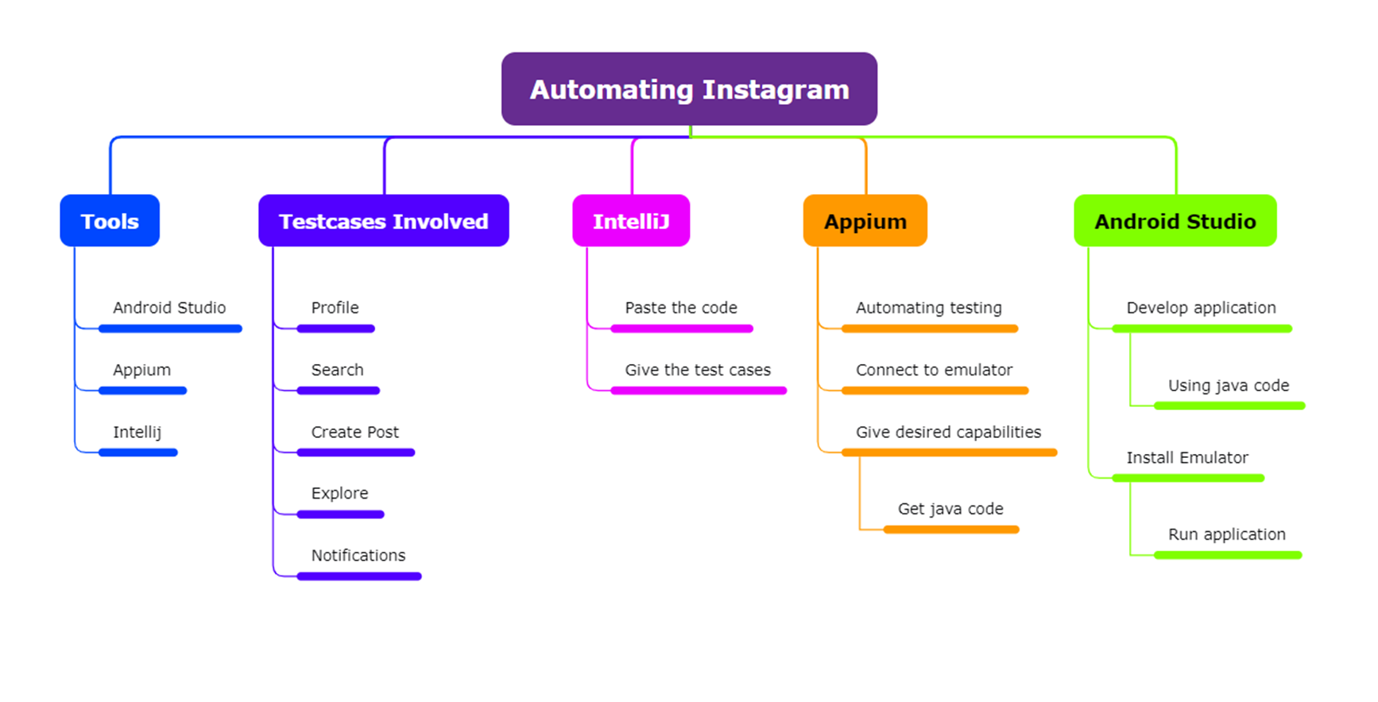
CONCEPT MAPPING

Slide 7




APP TOOLS
IntelliJ
Appium Server
Android Studio
Appium Inspector

Slide 8
INSTALLATION
Download Android Studio.
Install SDK in Android Studio.
Download Emulator in Android Studio.
Download Appium Server and Inspector.
Download and install IntelliJ.

Slide 9
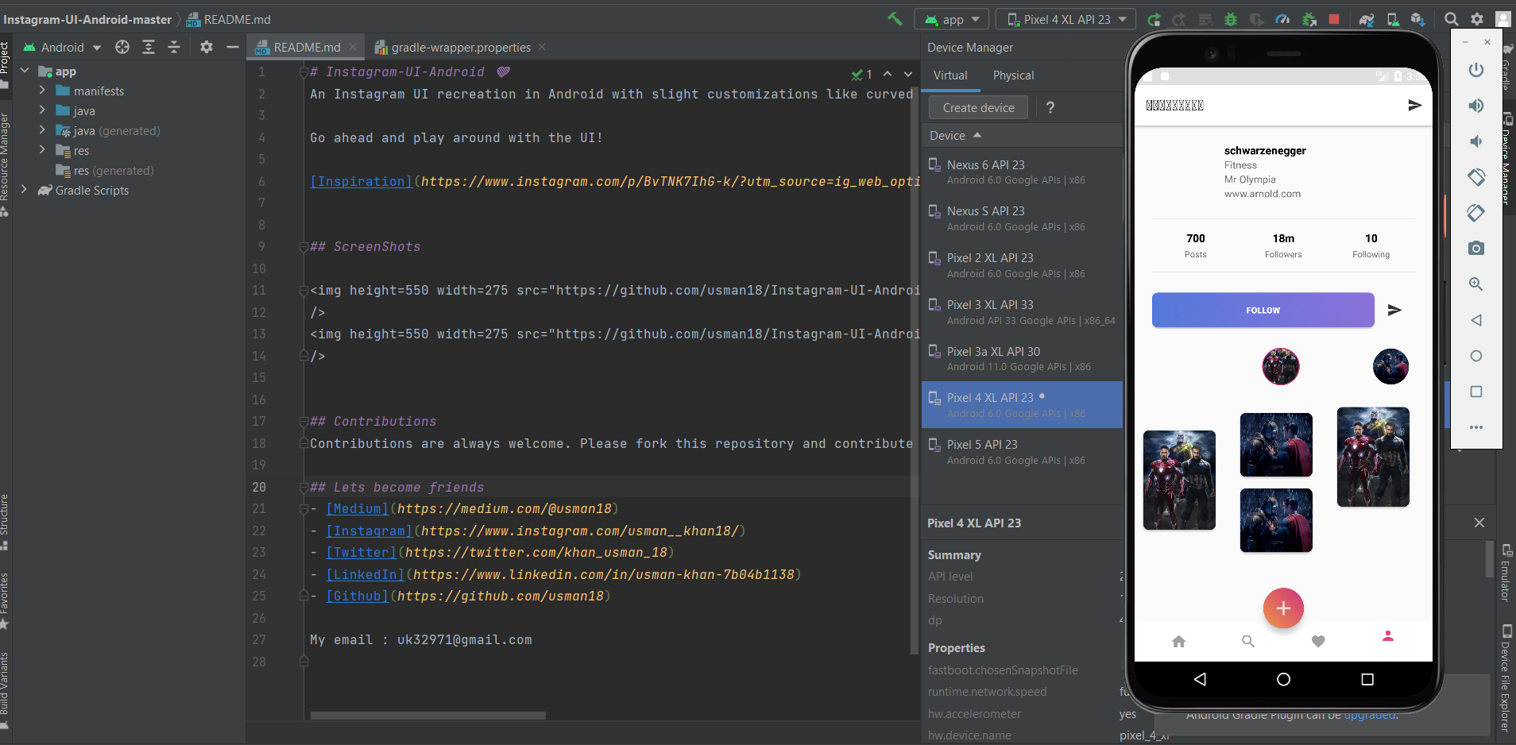
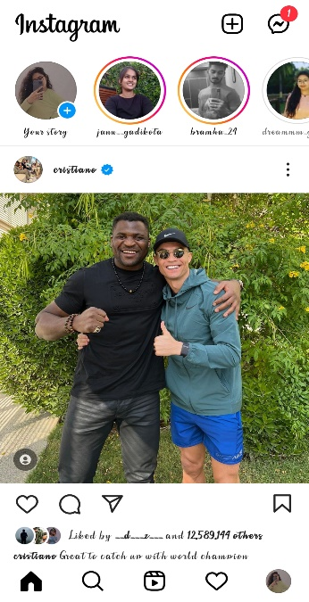
IMPLEMENTATION OF TESTING
Android studio

Slide 10
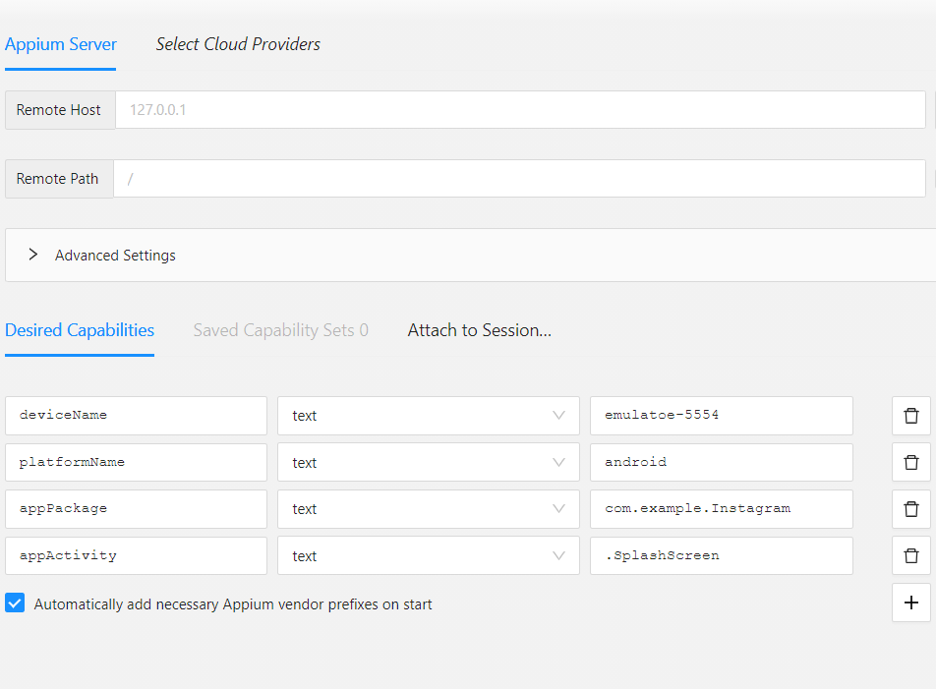
IMPLEMENTATION OF TESTING
Appium Inspector

Slide 11
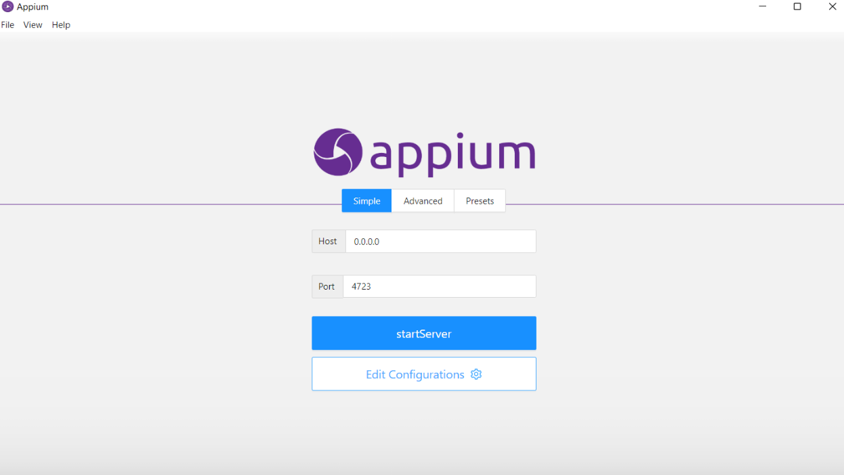

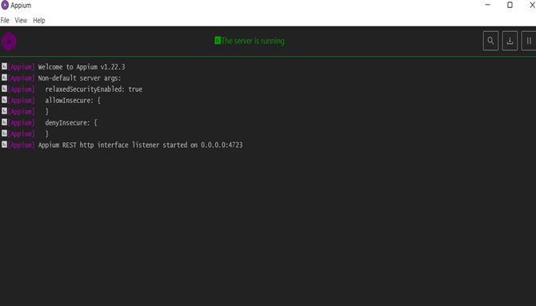
IMPLEMENTATION OF TESTING

Slide 12

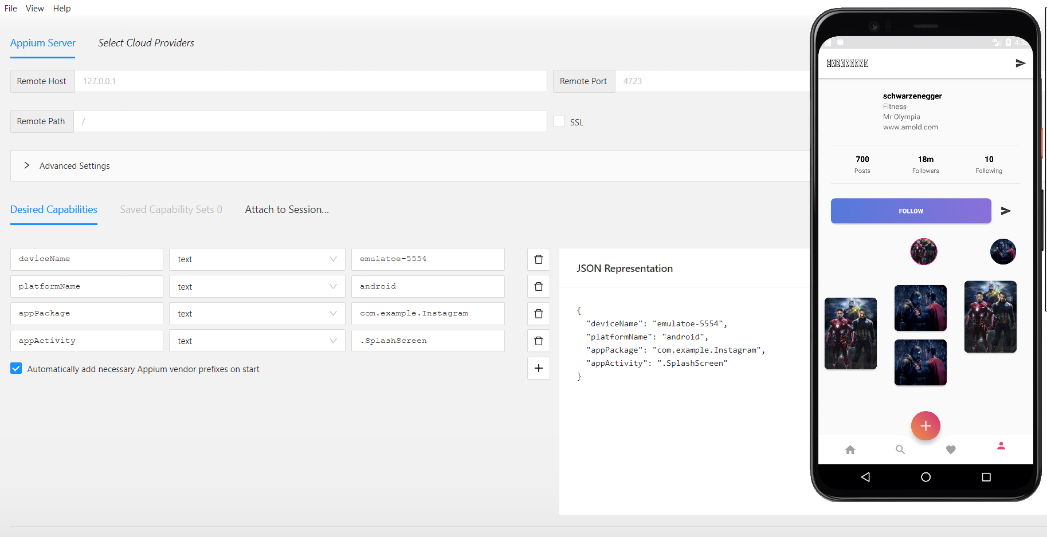
IMPLEMENTATION OF TESTING

Slide 13
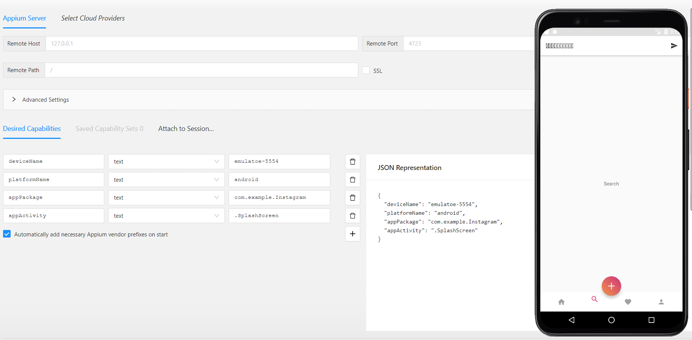
IMPLEMENTATION OF TESTING

Slide 14

TEST CASE OUTCOMES
TEST CASES | TYPES-POSITIVE/NEGATIVE
Enter the valid username and password | Positive
Enter the invalid username and password | X Negative
Check if strangers can check the story in private account | X Negative
Verify whether the share button is clickable or not | Positive
Verify whether the blocked contacts can message | X Negative
Check if the user can post the pictures from gallery or camera | Positive
Check if the user can post the multiple pics at the same time | Positive
Verify whether the user can text multiple persons at a time | X Negative
Verify whether hidden accounts can view the story | X Negative
Check if the user can accept or delete the follow requests | Positive
Verify whether the user can click photos in Instagram | Positive
Verify whether the user can share and edit their profile | Positive
Check if the user can like the pictures of the other accounts multiple times | X Negative

Slide 15
CONCLUSION
Hence , automation of Instagram is successfully done using Appium server and inspector with all the possible test scenarios.

Slide 16

THANK YOU

